Slide 1

Medical embryology
Basrah university/ college of medicine
Department of human anatomy
DR.SAMER AL-NUSSAIRI

Slide 2
OBJECTIVES
Concept of Medical Embryology
Values & significances of studying medical Embryology.
Somatic cells, Germ cells, Gamete ( Sex cell ), Zygote & Gametogenesis..

Slide 3
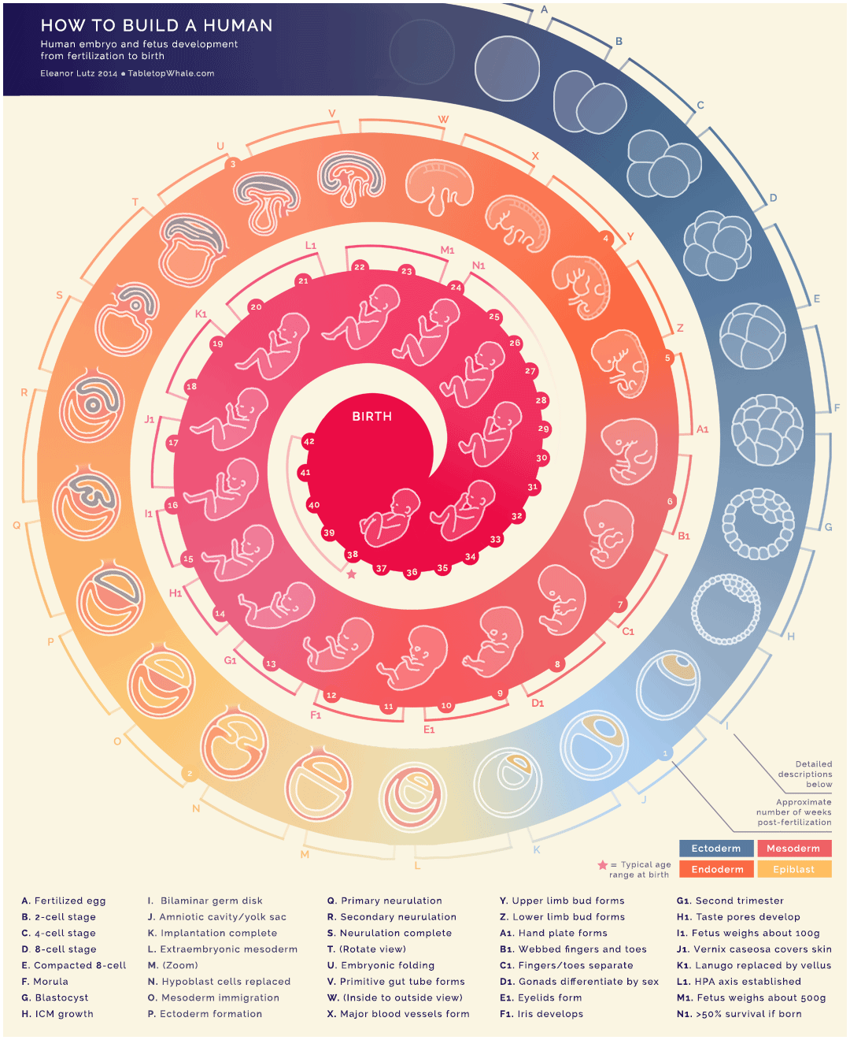
Medical Embryology
Embryology: Developmental process From a single cell to a baby in 9 months that represents an amazing integration of increasingly complex phenomena.
The field includes investigations of the molecular, cellular, and structural factors contributing to the formation of an organism.

Slide 4
Values & significances of studying medical Embryology
1-It’s necessary for proper understanding of anatomy. It explains certain relations which are seen in the body of adult person.
2-It’s important for the study of histology. It explains how different tissues and organs develop from a single cell (zygote) , after cell differentiation.
3- It’s important for study of pathology, sometime, result of embryonic development leads to formation of congenital abnormalities.
4.Thus it provides knowledge essential for creating health care strategies for better reproductive outcomes.

Slide 5
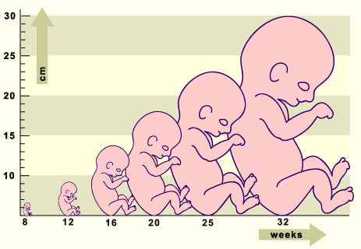
General Embryology
The embryonic period, or period of organogenesis, occurs from the 3rd
to the 8th weeks of development and is the time when each of three germ layers ( ectoderm, mesoderm and endoderm) gives rise to a number of specific tissues & organs.
The fetal period is period from the beginning of the 9th weeks to birth. It is characterized by maturation of tissues & organs with rapid growth of the body.
.

Slide 6
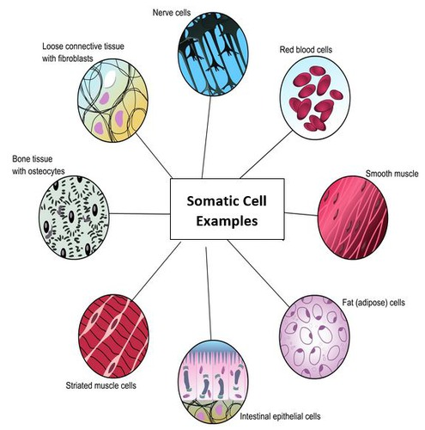
Somatic cell
A somatic cell is any cell of the body except sperm and egg cells. Somatic cells are diploid, meaning that they contain two sets of chromosomes, one inherited from each parent.

Slide 7
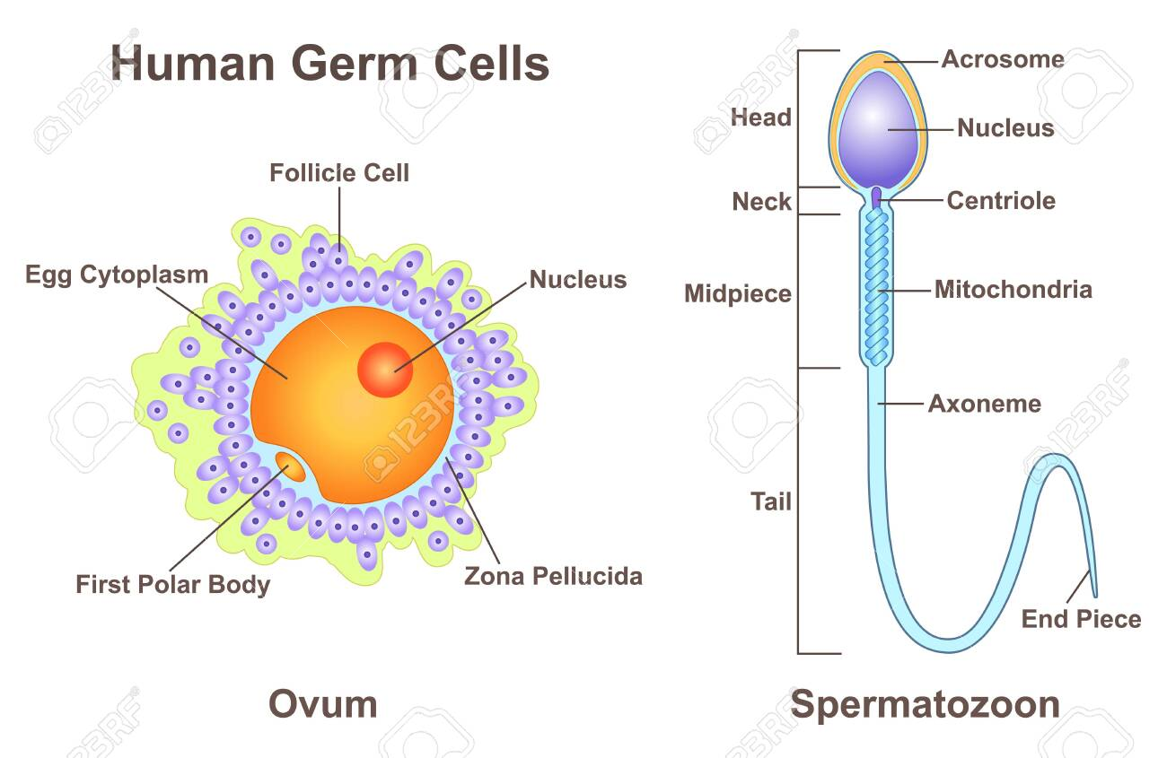
Germ cells
Reproductive cells located only in the gonads. It contains half the number of chromosomes (23N ) of a somatic cell and able to unite with one from the opposite sex to form a new individual; a gamete (46 N)

Slide 8
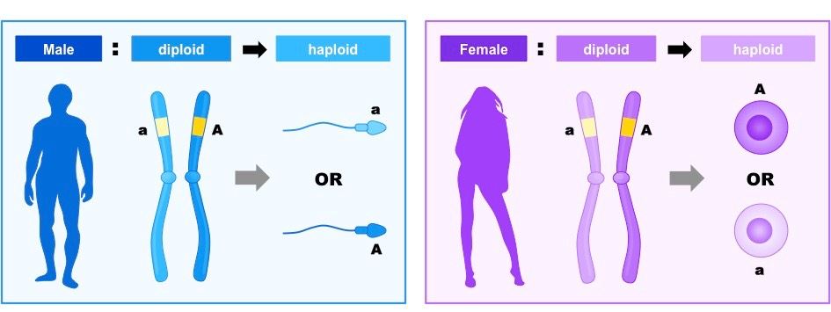
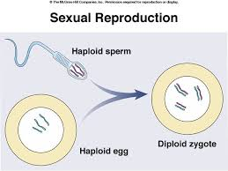
Gamete ( Sex cell )
Female gametes are called ova or egg cells.
Male gametes are called sperm.
Gametes are haploid cells, and each cell carries only one copy of each chromosome (23 Chromosomes).

Slide 9
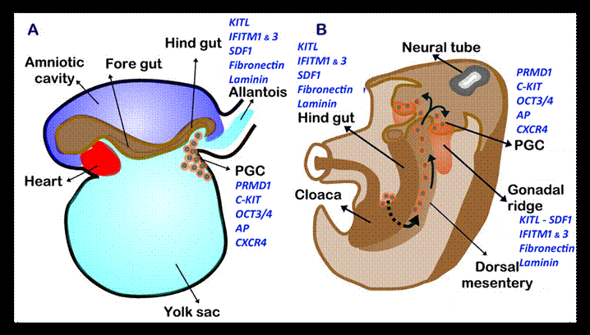
Primordial germ cells ( PGC)
Specialized cells that are precursors of gametes . It develops at second week and start to migrate from yolk sac toward the developing gonad and reach it by the end of 5th week . It undergoes mitoses to increase the number and then meiosis to complete its maturation to sperm or eggs that generate a new organism upon fertilization.

Slide 10
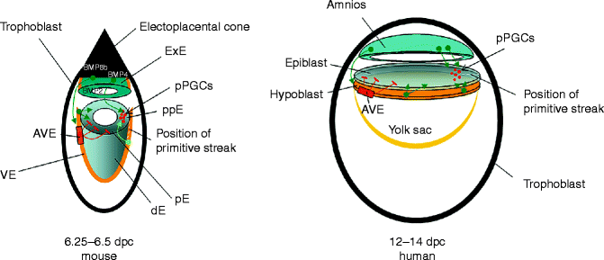
Primordial germ cells ( PGC)
Primordial germ cells (PGCs) are induced in the embryonic epiblast, before migrating to the gonads

Slide 11
Primordial Germ cell teratoma
An embryonic carcinoma consist of a combination of the tissues from all three blastodermic layers (ectoderm,mesoderm and endoderm) as hair, bone, muscles, gut.

Slide 12
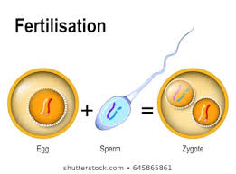
Zygote
A zygote is the union of the sperm cell and the egg cell. Also known as a fertilized ovum, the zygote begins as a single cell but divides rapidly in the days following fertilization. The zygote eventually becomes an embryo.

Slide 13
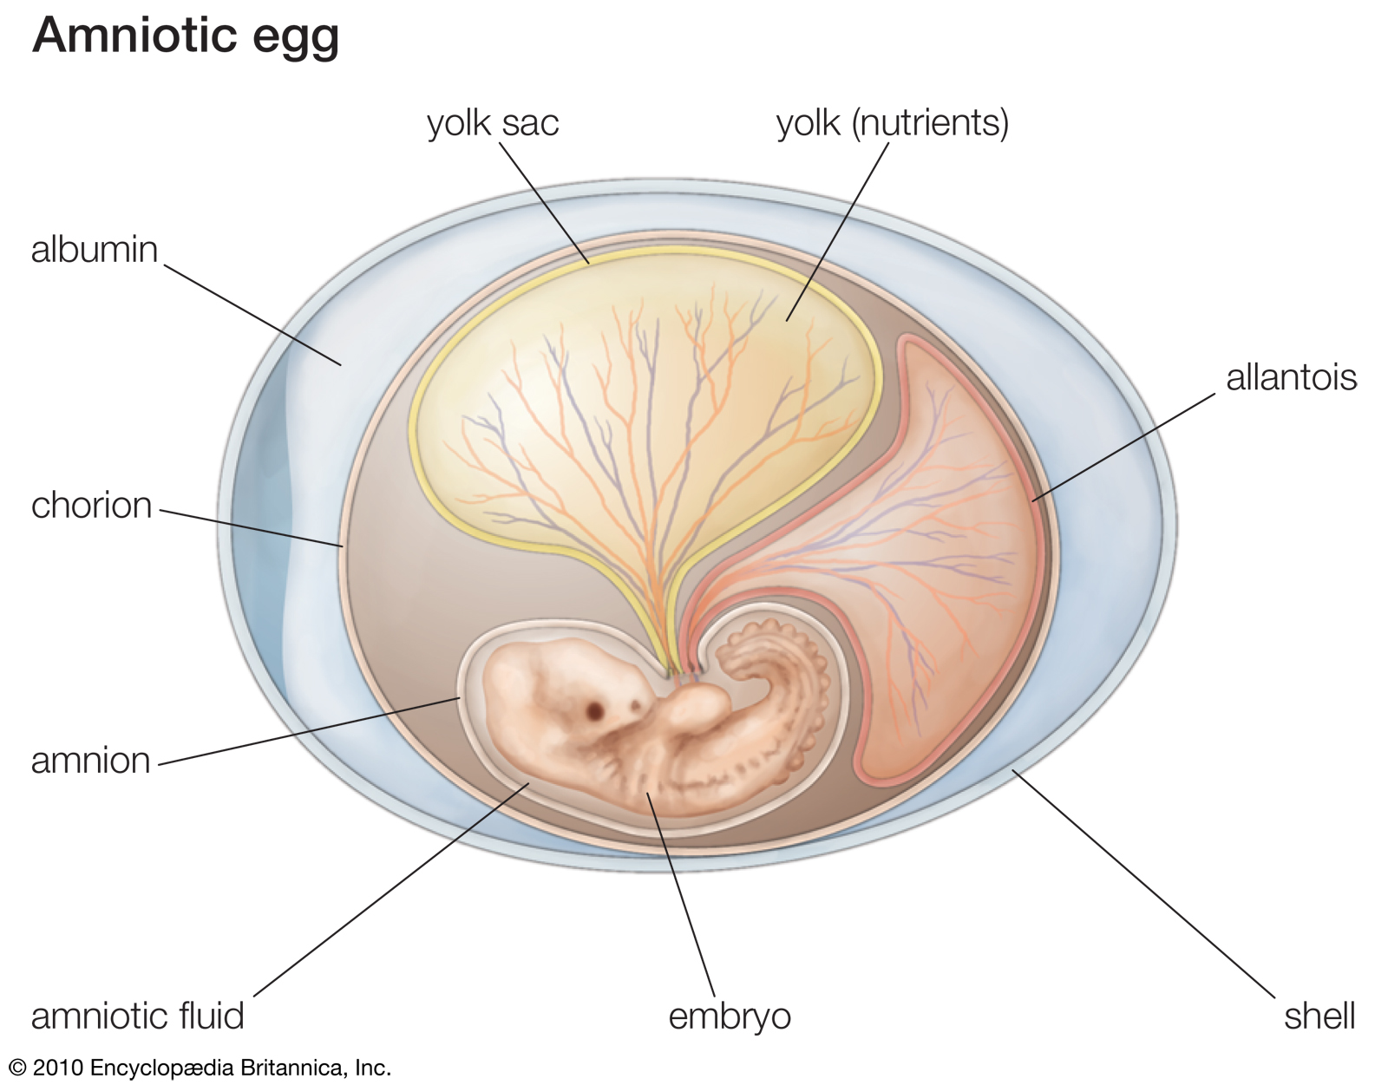
Yolk sac
The yolk sac is a small, membranous structure situated outside of the embryo that has a variety of functions during embryonic development. It attaches ventrally to the developing embryo via the yolk stalk.
Before the placenta is formed, the yolk sac provides nutrition and gas exchange between the mother and the developing embryo.

Slide 14
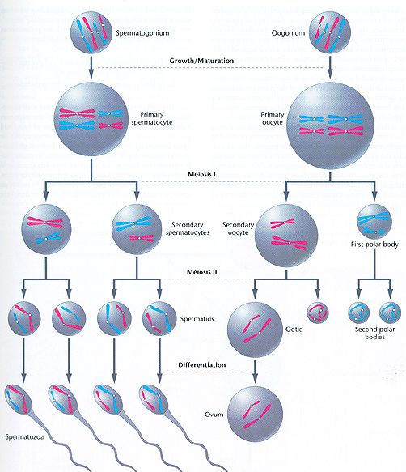
Gametogenesis
Gametogenesis is the series of events that leads to the production of haploid gamete from diploid cells.

Slide 15
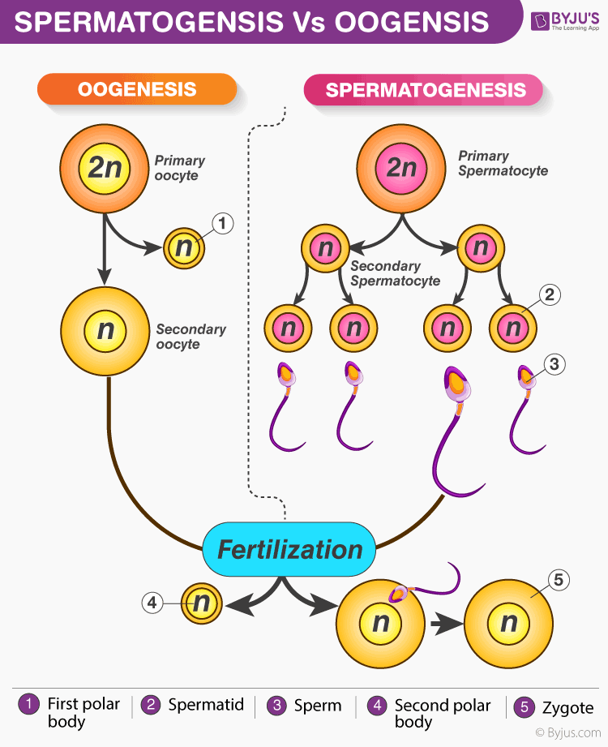
Gametogenesis
Spermatogenesis is the production of sperm in the male testes .
Oogenesis is the production of ova within the ovaries.

Slide 16
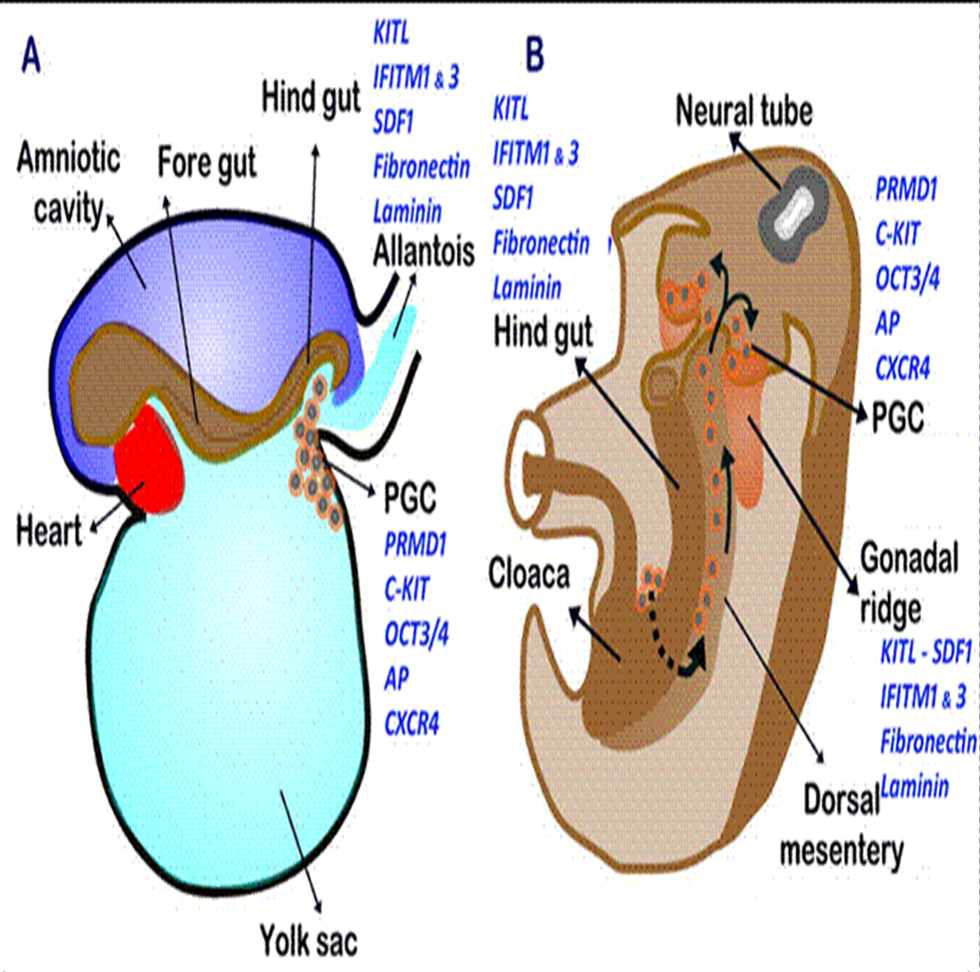
Gametogenesis
They migrate to a structure known as gonadal ridge. These migrating cells are known as gonocytes.

Slide 17
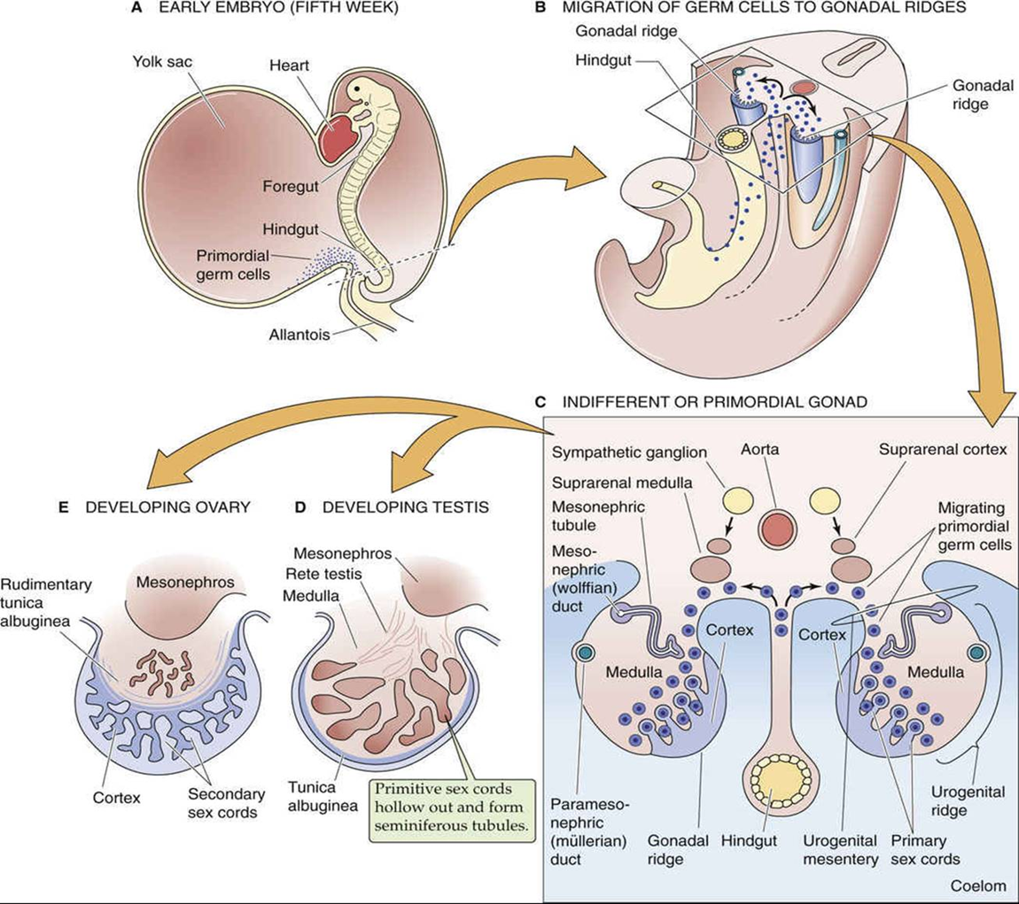
Gametogenesis
- At their arrival on the ridge, they become surrounded by the cells on the ridge and the change the appearance on the ridge based on their contents.

Slide 18
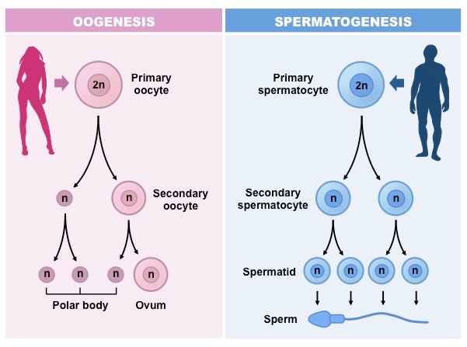
Gametogenesis
- During the time of migration and after arrival at the ridge, the PGC undergoes mitotic to increase its number and divisions to produce sperm or ovum.

Slide 19


